Slide 1
When
TWO
LIONS
MET

Slide 2
TWO
SATAN
1 Pet. 5:8
Jn. 8:44
Gen. 3:1-6
Eph. 2:2
JESUS
Rev. 5:5, 6
Jn 14:6; 10:25
Heb. 4:15
Jn. 8:29
Genesis 3:15

Slide 3
WHEN
1. BETHLEHEM
Matt. 2:1, 16; Rev. 12:3-5, 9
2. THE WILDERNESS
Matt. 4:1-11; Mk. 1:12, 13

Slide 4
WHEN
3. PERSONAL MINISTRY
CHARACTER Lk. 7:34
INSPIRATION Lk. 7:37-50
AUTHORITY Lk. 20:1-8
IDENTITY Jn. 10:17-21; 31-33

Slide 5
WHEN
4. GETHSEMANE
Matt. 26
5. BEFORE PILATE
Matt. 27:11-24

Slide 6
WHEN
6. AT THE RESURRECTION
Heb. 2:14, 15; Rom. 1:4
7. END OF TIME
Matt. 25:41; Rev. 20:10

Slide 7
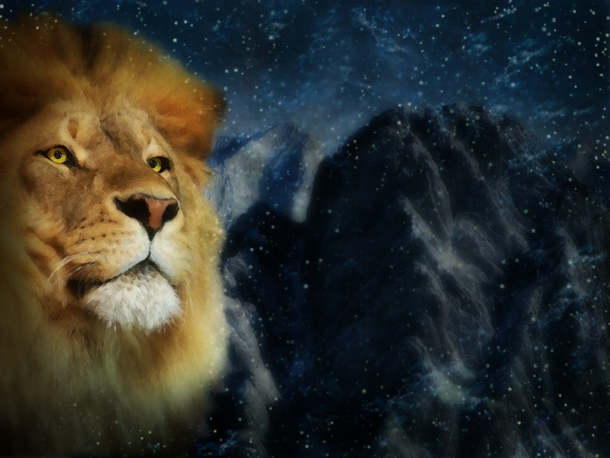

In the
BALANCE
of the
Battle Was Our

Slide 8
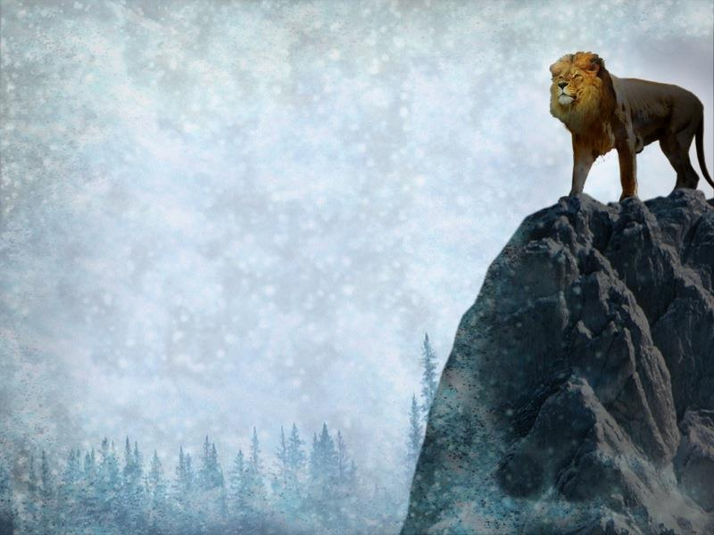
Let us be
THANKFUL and never grow
FORGETFUL of our
VICTORY IN CHRIST!
“… Do not weep. Behold, the Lion of the tribe of Judah…” (Rev. 5:5)
Col. 3:15 | 2 Pet. 1:1-9 | 1 Cor. 15:57, 58

